Slide 1
CUDA Programming Data Parallel Execution Model
Thien Lu
12 July 2024

Slide 2
Table of Contents
1. CPU vs GPU
2. Data Parallel Execution Model
Single Program Multiple Data (SPDM)
Grid, Block and Threads
Kernel Function
Examples: Vector Addition, RGB to Gray Scale, Matrix multiplication (naive)
3. Thread scheduling

Slide 3
1. CPU vs GPU

Slide 4
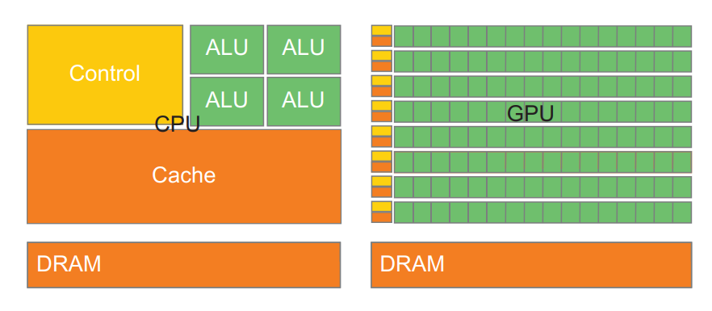
1. CPU vs GPU
CPU
GPU
CPU is one-thread execution, run as much fast as possible in sequential pattern.
CPUs can be 10+X faster than GPUs for sequential code.
Massive parallelism. Multi-thread, faster for parallel parts where throughput wins.
GPUs can be 10+ X faster than CPUs for parallel code.

Slide 5
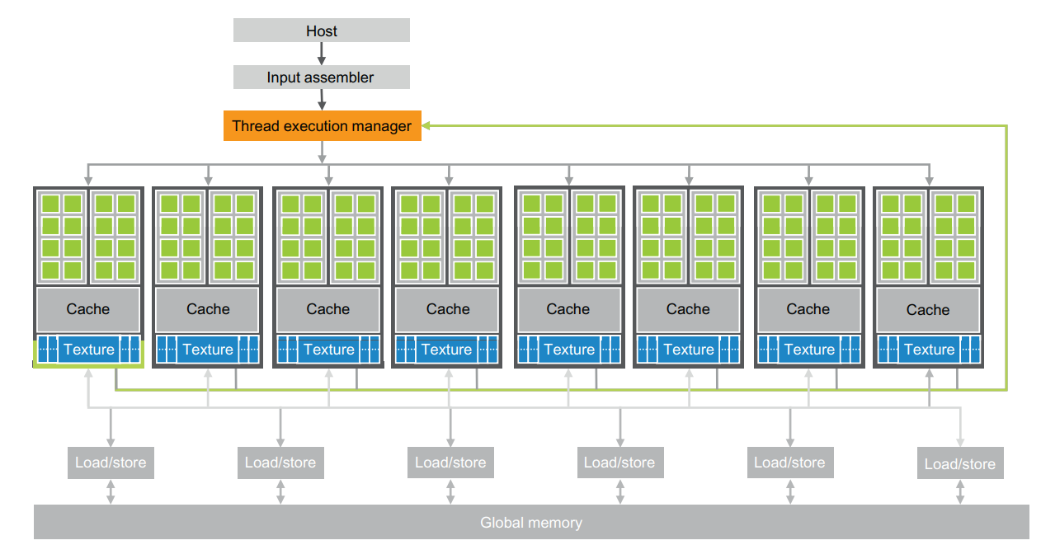
1. CPU vs GPU
Textbook: Figure 1.2

Slide 6
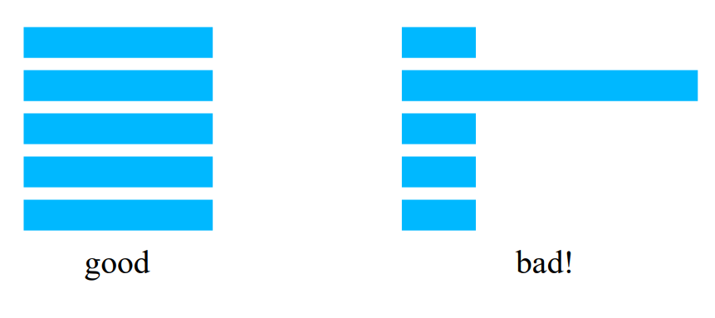
1. CPU vs GPU
Load balance
The total amount of time to complete a parallel job is limited by the thread that takes the longest to finish
→ Depend on the way how we choose to do the parallel.
→ Way to utilize the global memory bandwidth, data accesses can cause serialization and delays.

Slide 7
2. Data Parallel Execution Model

Slide 8

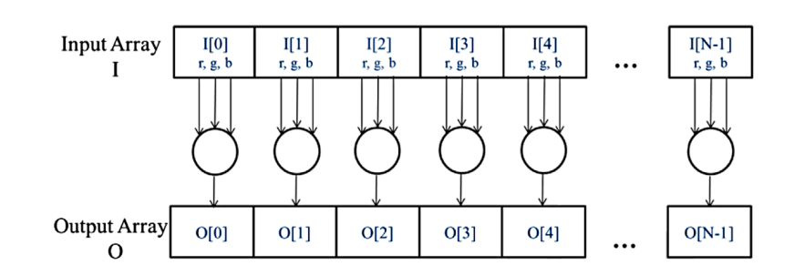
2. Data Parallel Execution Model
Data Parallelism
(Re)Organize the computation around the data, such that we can execute the resulting independent computations in parallel to complete the overall job.
Textbook: Section 2.1

Slide 9
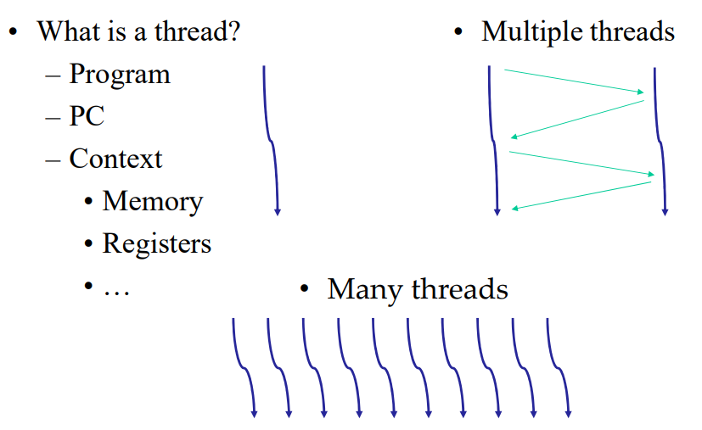
2. Data Parallel Execution Model
Thread – basic unit of computing
A thread of execution is the smallest sequence of programmed instructions that can be managed independently by a scheduler. (Wikipedia)

Slide 10
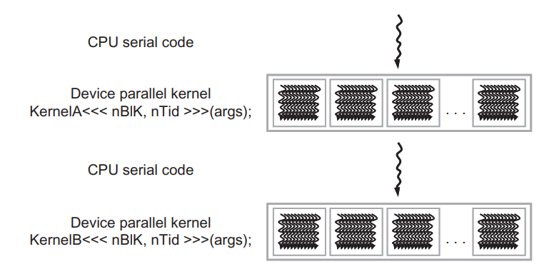
2. Data Parallel Execution Model
CUDA – Execution Model
Threads
Block
Textbook: Figure 2.4
Grid

Slide 11
2. Data Parallel Execution Model

Slide 12
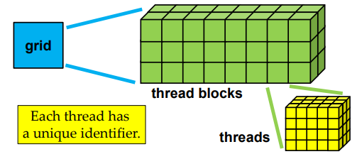
2. Data Parallel Execution Model
CUDA – Execution Model
Single Program Multiple Data (SPMD) model : CUDA execute as grid/ array of threads (same kernel code/ same program), each thread has unique index for addressing.
gridDim.x = 8
blockIdx
gridDim.y = 3
gridDim.z = 2
threadIdx
Same size!!
blockDim.x = 5
blockDim.y = 4
blockDim.z = 3

Slide 13
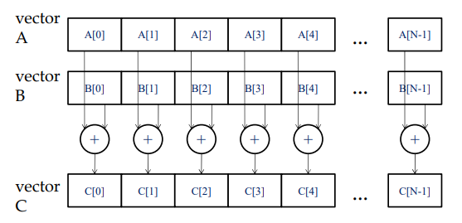
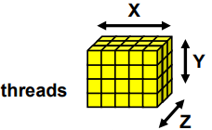
2. Data Parallel Execution Model
Grid(Blocks(Threads))
- gridDim (x, y, z) is configured and blockIdx(x, y, z) is unique for each block per grid
- blockDim (x, y, z) is configured and threadIdx(x, y, z) is unique for each thread per block
→ These indices help to address data elements for unpacking and packing.
TODO: How many blocks per SM? Parallel or sequential?
CUDA version >= 3.0: max 1024 threads/block
CUDA version < 3.0: max 512 threads/block
Textbook: Section 2.5 pg.33

Slide 14
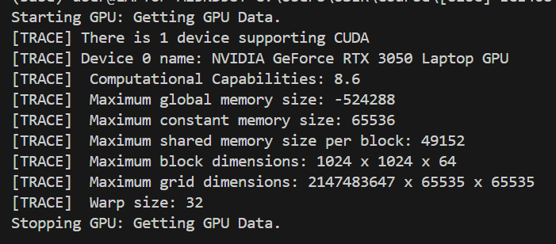
2. Data Parallel Execution Model
Assignment: MP0

Slide 15
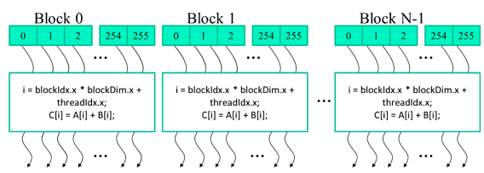
2. Data Parallel Execution Model
Which part of output this thread represents for?
threadId.x= blockIdx.x * blockDim.x + threadIdx.x
threadId.y = blockIdx.y * blockDim.y + threadIdx.y
threadId.z = blockIdx.z * blockDim.z + threadIdx.z
threadIdx: local index used within one block
threadId: unique global index of threads within the entire grid
blockDim.x = 256 (blockDim.y = blockDim.z = 1) and 2 vectors A[500], B[500] → C = A + B
Textbook: Section 2.5 pg.34

Slide 16
2. Data Parallel Execution Model
SPMD (Single Program) vs SIMD (Single Instruction)
#TODO
Textbook: Section 2.5 pg.33
Note that SPMD is not the same as SIMD (Single Instruction Multiple-Data) [Flynn 1972]. In an
SPMD system, the parallel processing units execute the same program on multiple parts of the data.
However, these processing units do not need to be executing the same instruction at the same time. In
an SIMD system, all processing units are executing the same instruction at any instant.

Slide 17
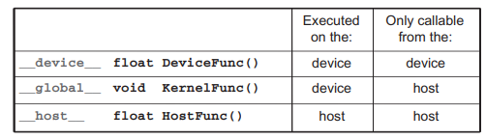
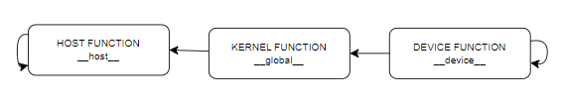
2. Data Parallel Execution Model
_ _ (2 underscores)
HOST
DEVICE
Note:
- We can use both __device__ and __host__ for the same function declaration.

Slide 18
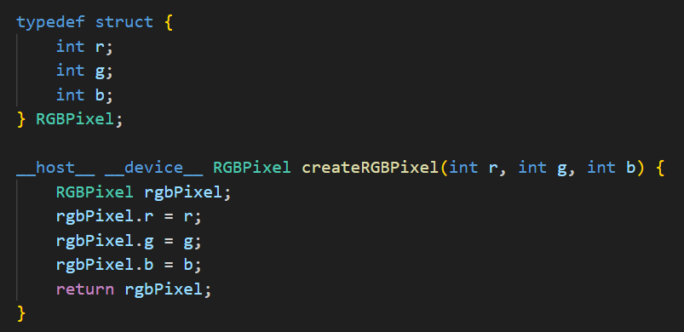
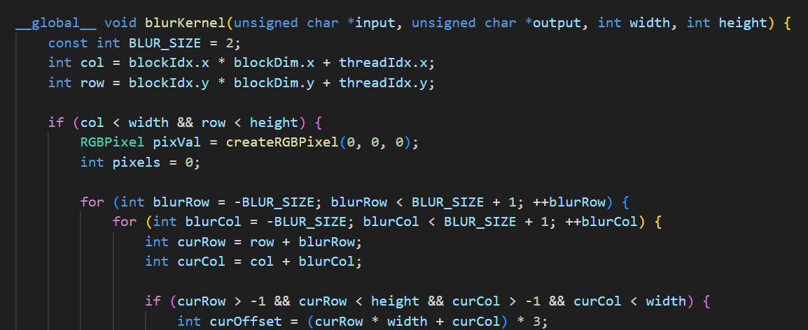
2. Data Parallel Execution Model
Note:
- We can use both __device__ and __host__ for the same function declaration.

Slide 19
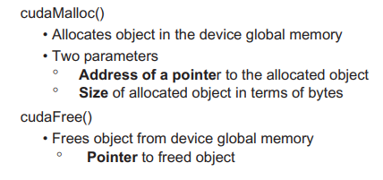
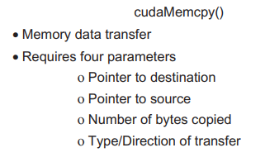
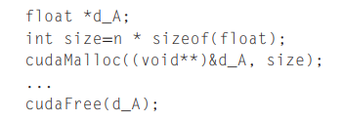
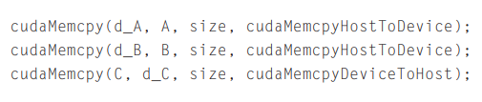
2. Data Parallel Execution Model
CUDA API #include <cuda_runtime.h>

Slide 20
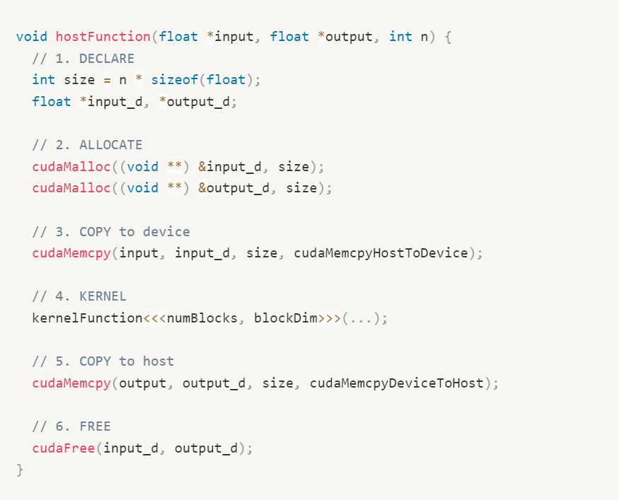
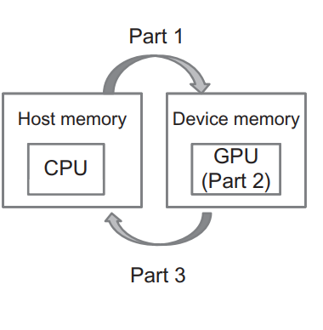
2. Data Parallel Execution Model
Stub function
Part 1
Part 2
Part 3

Slide 21
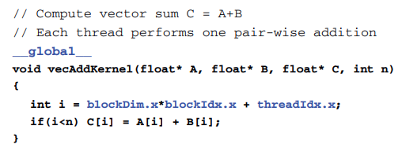
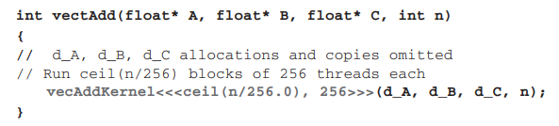
2. Data Parallel Execution Model
Loop parallelism
Define vector indices a thread takes to process
Perform calculation based on the index condition
Execution configuration parameters
<<<blocks, threads>>>
Ensure enough threads to cover all elements

Slide 22
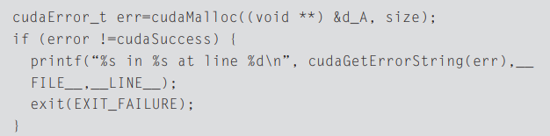
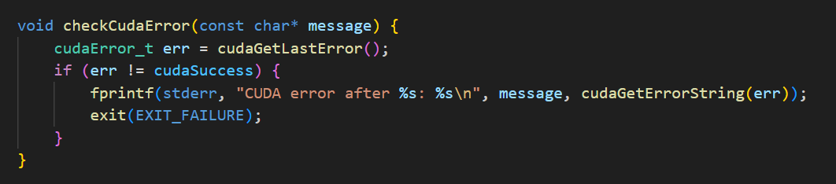
2. Data Parallel Execution Model
CUDA API Error handling
In practice, we should surround the call with code that test for error condition and print out error messages: cudaError_t or cudaGetLastError()
Textbook: Section 2.4 pg.32
Textbook: Section 13.5 pg.284

Slide 23
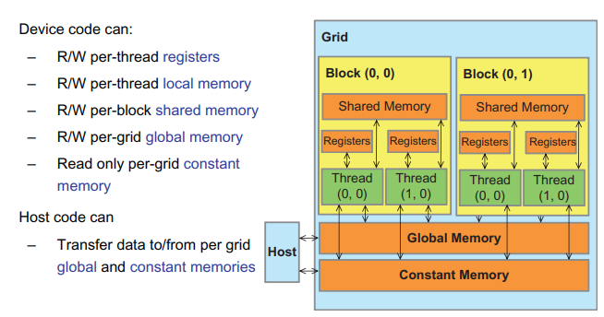
2. Data Parallel Execution Model
Data allocation
(automatic variable)
(automatic array)
(shared)
(global)
(constant)

Slide 24
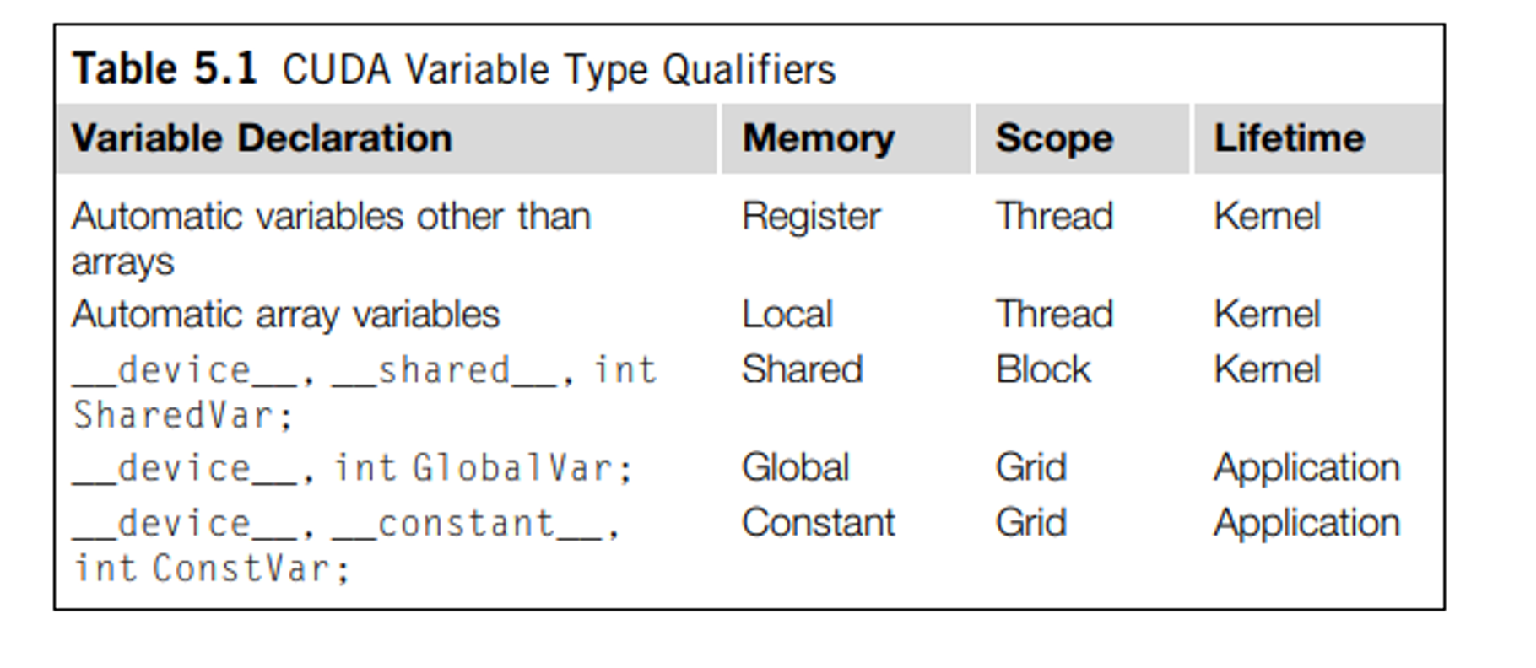
2. Data Parallel Execution Model
Data allocation

Slide 25
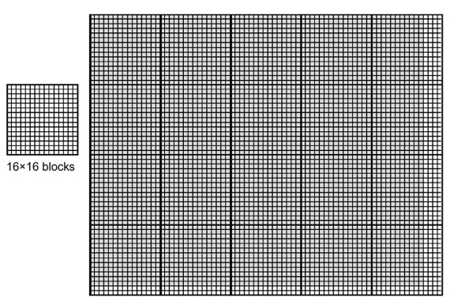
2. Data Parallel Execution Model
Multidimensional data
76 × 62 picture
16 x 16 blocks
gridDim 5 x 4

Slide 26
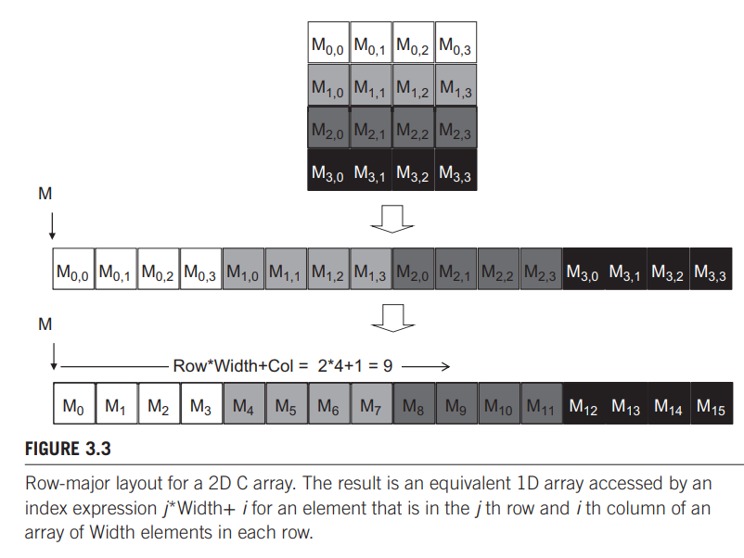
2. Data Parallel Execution Model
Multidimensional data

Slide 27
2. Data Parallel Execution Model
Multidimensional data
B_{0,0} | B_{0,1} | B_{0,2} | B_{0,3}
B_{1,0} | B_{1,1} | B_{1,2} | B_{1,3}
B_{2,0} | B_{2,1} | B_{2,2} | B_{2,3}
B_{3,0} | B_{3,1} | B_{3,2} | B_{3,3}
G_{0,0} | G_{0,1} | G_{0,2} | G_{0,3}
G_{1,0} | G_{1,1} | G_{1,2} | G_{1,3}
G_{2,0} | G_{2,1} | G_{2,2} | G_{2,3}
G_{3,0} | G_{3,1} | G_{3,2} | G_{3,3}
R_{0,0} | R_{0,1} | R_{0,2} | R_{0,3}
R_{1,0} | R_{1,1} | R_{1,2} | R_{1,3}
R_{2,0} | R_{2,1} | R_{2,2} | R_{2,3}
R_{3,0} | R_{3,1} | R_{3,2} | R_{3,3}
row-major layout
R_{0,0} | G_{0,0} | B_{0,0}
R_{0,1} | G_{0,1} | B_{0,1}
R_{0,2} | G_{0,2} | B_{0,2}
R_{0,3} | G_{0,3} | B_{0,3}
R_{1,0} | G_{1,0} | B_{1,0}
…

Slide 28
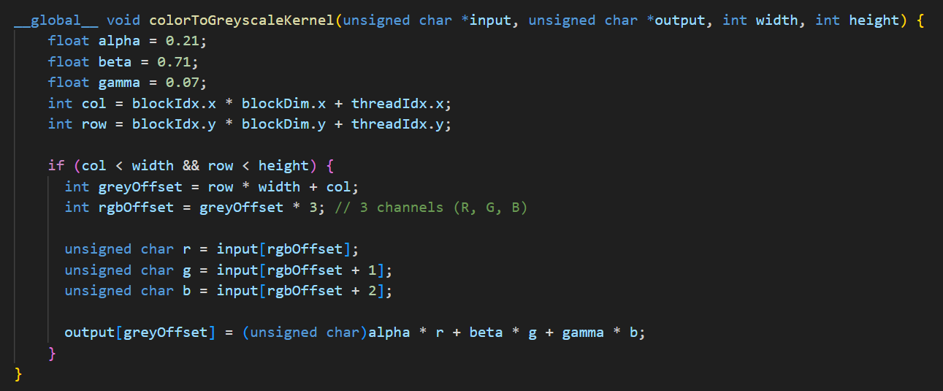
2. Data Parallel Execution Model
RGB to Greyscale conversion

Slide 29
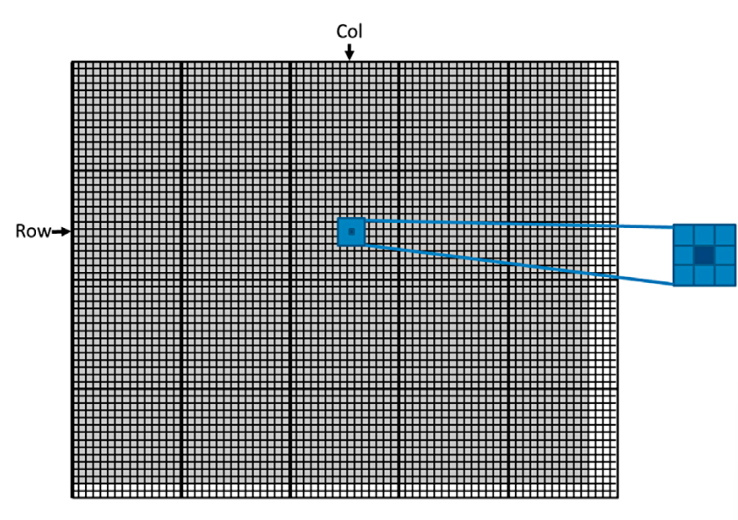
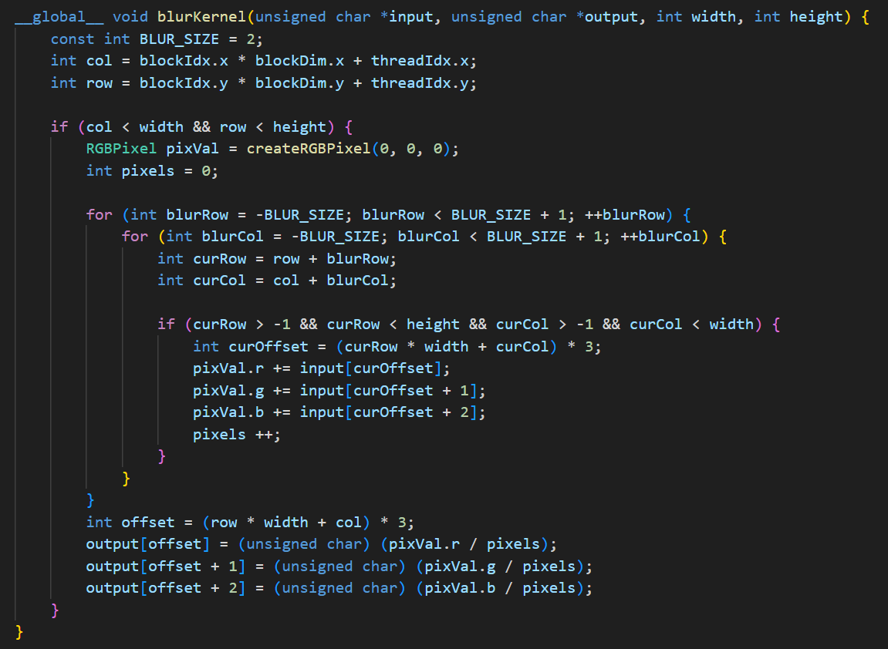
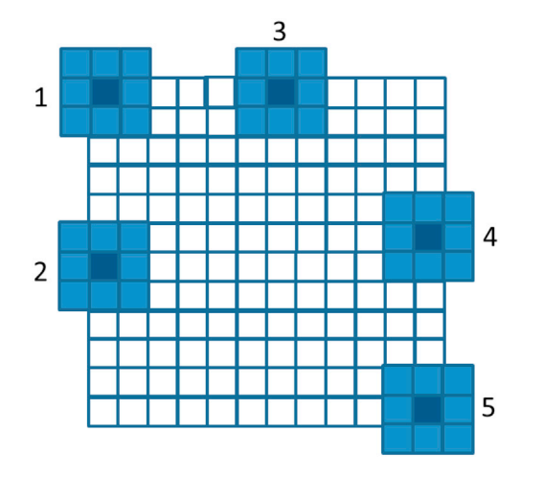
2. Data Parallel Execution Model
Image Blurring

Slide 30
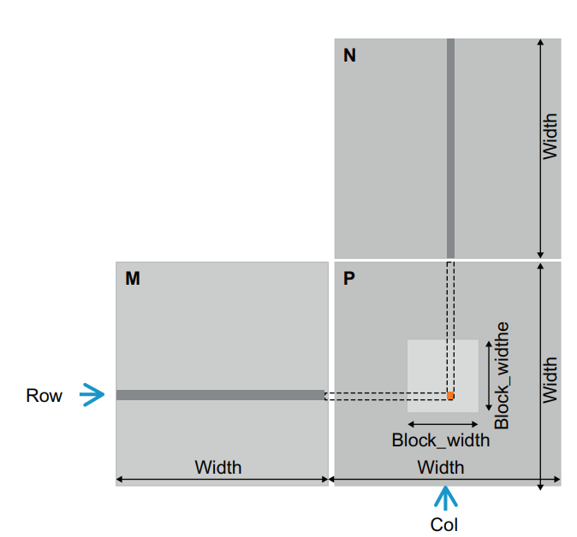
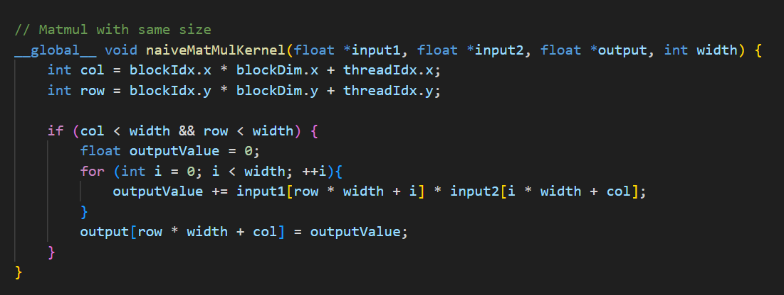
2. Data Parallel Execution Model
Matrix Multiplication (naïve)
- Each thread represents for each output pixel
- Each thread input data is the corresponding row of M and column of N

Slide 31
3. Thread scheduling

Slide 32
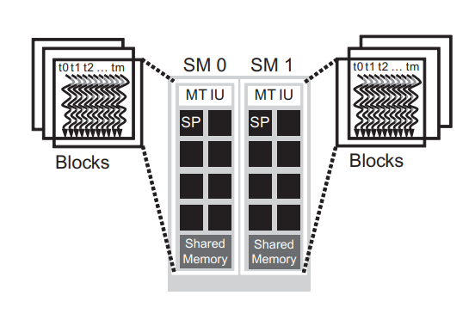
3. Thread scheduling
- When launch the kernel, a block can begin execution only when the runtime system has secured all resources needed.
+ In current hardware generations, execution resources are organized into Streaming Multiprocessors (SMs).
+ Each device sets limited number of blocks and threads can be assigned to each SM.

Slide 33
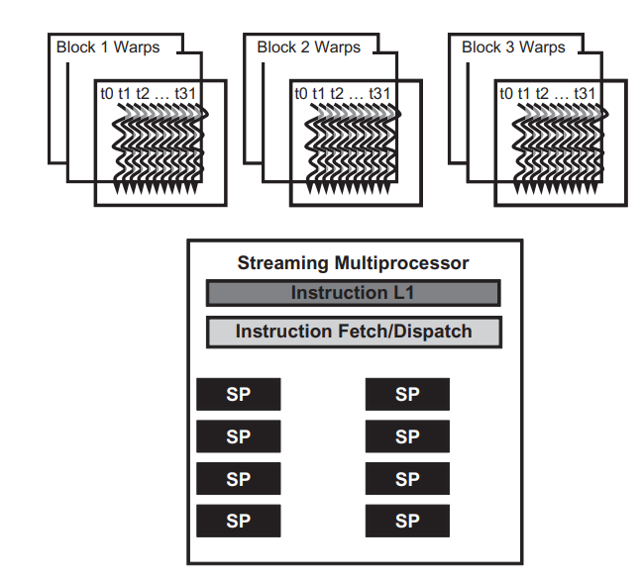
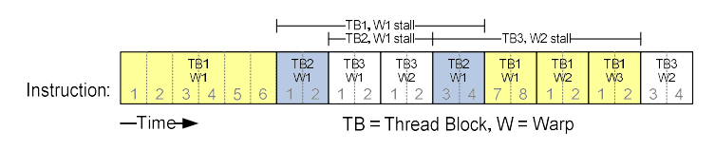
3. Thread scheduling
- Thread scheduling is hardware-implementation dependent.
+ Majority of implementations to date, a block assigned to an SM is further divided into 32 thread units called warps (implementation-specific).
+ Warp is a unit of thread scheduling in SMs.
Why is block divided into warps?
- Each SM has only enough hardware to execute instructions from a small subset of all threads assigned to the SM at any point in time.

Slide 34
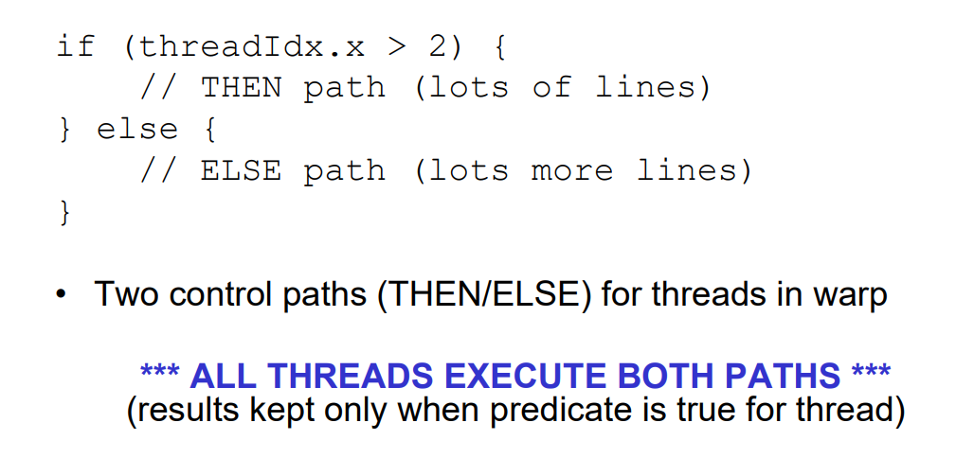
3. Thread scheduling
Branch divergence
WARP_SIZE = 4
Warp0: (thread 0 → 3)
Warp1: (thread 4 → 7)
…

Slide 35
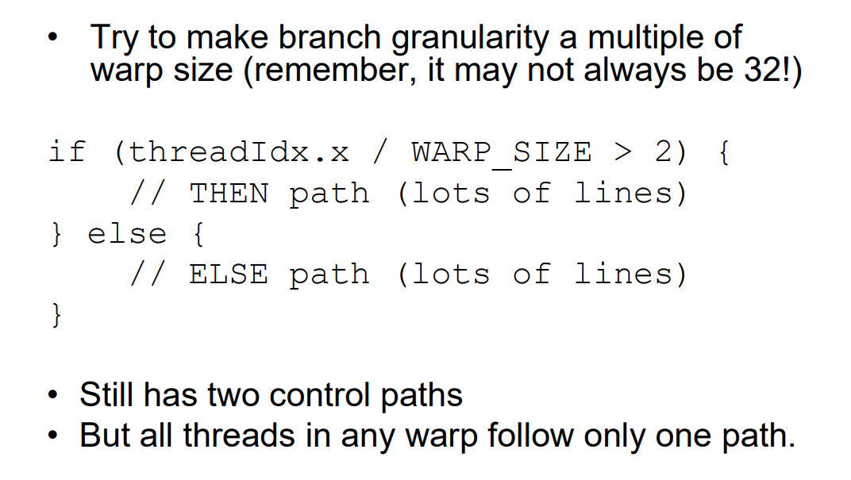
3. Thread scheduling
Branch divergence
WARP_SIZE = 4
Warp0: (thread 0 → 3)
Warp1: (thread 4 → 7)
…

Slide 36
3. Thread scheduling
Block Granularity Considerations
For colorToGreyscaleConversion, should one use 8×8, 16×16 or 32×32 blocks? Assume that in the GPU used, each SM can take up to 1,536 threads and up to 8 blocks.
blockDim | Calculated numBlocks | Calculated threads used | Actual numBlocks | Actual threads used
8x8 | floor(1536 / 64) = 24 | 24 * 64 = 1536 | 8 | 8 * 64 = 512
16x16 | 6 | 1536 | 6 | 1536
32x32 | 1 | 1024 | 1 | 1024

